Slide 1

Understanding of AI-Based Recruitment Outcomes
Capstone project - Phase A
25-1-R-6
Presented by:
Alin Migdalovich & Yoav Katz
Supervisors:
Dr. Julia Sheidin & Dr. Avital Shulner Tal

Slide 2
Motivation
The recruitment process in the software industry today
Recruitment lacks clarity in decision-making.
Job seekers struggle to optimize resumes.
Automated systems don’t explain how they make decisions
2

Slide 3
Background and Related work
3

Slide 4
Recruiting Process and Parameters
Recruitment evaluates skills, education, experience.
Challenges: large volume, bias, time pressure.

Slide 5
Our dataset
Contains 150 resumes of engineers
Roles: ML, AWS, MERN Stack
Features: skills, education, experience
Match percentage measures candidate-job alignment
Includes match percentages for training data
Dataset split: train and test groups
Designed to predict job match scores
More info on the dataset at Kaggle
Notes:
להציג את האלגוריתם ואיך הציון מחושב להציג קבוצת train

Slide 6
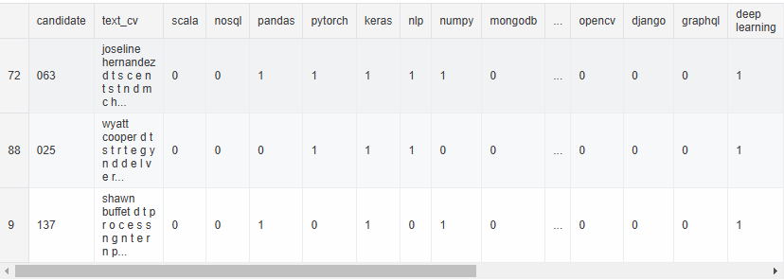
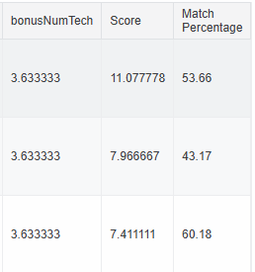
Ranking code output
🤷Why?
Notes:
להציג את האלגוריתם ואיך הציון מחושב להציג קבוצת train

Slide 7

XAI Tools
SHAP: Analyze global feature impact on matching score.
LIME: Explain local, instance-specific CV.
CARLA: Counterfactual explanations
Notes:
LIME: treating the model as a black box, we perturb the instance we want to explain and learn a sparse linear model around it. CARLA is a python library to generate and benchmark counterfactual explanation

Slide 8
Our contribution
7

Slide 9
Our goal
Present and explain the match percentage of a new CV.
Explain AI decisions in resume matching: Combines global and local AI explanations.
Provide clear, actionable insights to users: Helps job seekers refine their applications to help candidates improve their match scores.
8

Slide 10
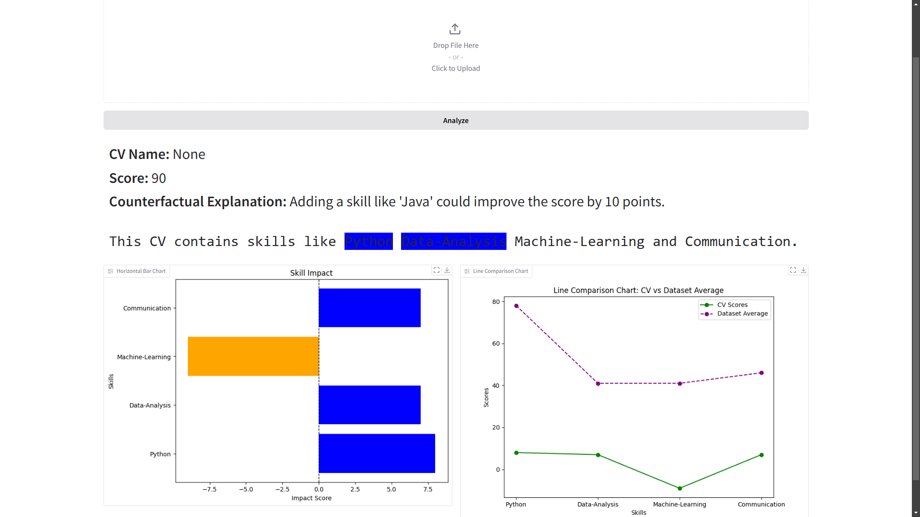
Local visualization
Horizontal Bar Chart
Feature Attribution
Student
Notes:
Local (for one CV) Feature Attribution (markering the relevant text on cv) python and data analysis is a positive impact while student is a negative one.
Bar size is impact value replace color

Slide 11
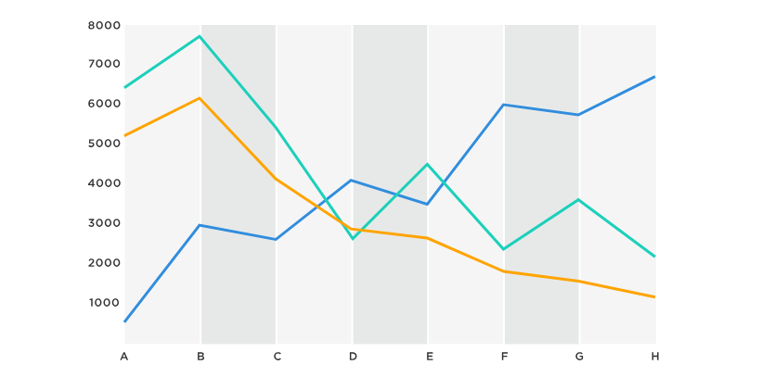
Global visualization
Line comparison Chart
The properties will be interactive (filtering)
Notes:
(properties on match score. you vs. dataset average) Global (compared to dataset)

Slide 12
Flow
Upload resume for analysis
Imply SHAP, LIME and CARLA
1
3
2
4
Match algorithm generates score
Visual and textual feedback displayed

Slide 13
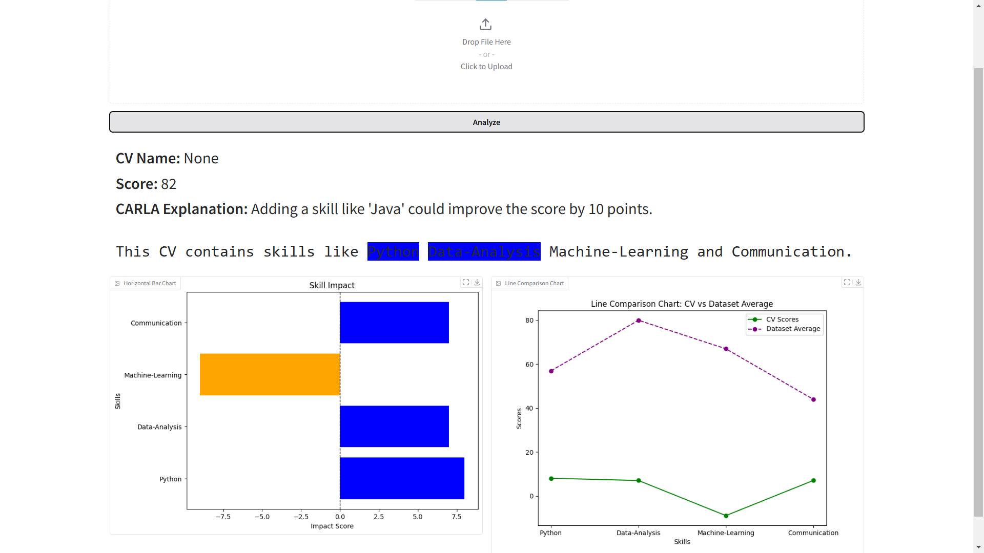
GUI
Notes:
שימו לב שההסבר שרשמתם לא הגיוני להסביר את הגרפים והצבעים feature importance נגדיל פונטים

Slide 14
Challenges
Studying and Integrating SHAP,LIME and CARLA explanations.
Balancing textual and visual explanations.
Explaining complex AI decisions clearly.
Translating results for non-technical users.
Notes:
לדבר בזמן עתיד

Slide 15
Evaluation plan
4
14

Slide 16

Testing plan
The system will generate:
Textual explanations and visualizations
SHAP explanations
LIME explanations
CARLA explanations
Data preprocessing code:
Rank multiple CVs by match percentage for a single job description.

Slide 17
User evaluation
Test system with students and HR experts.
Assess clarity and usability of explanations.
Ensure alignment with HR recruitment criteria.

Slide 18

THANKS!
Any questions?

